Slide 1

Final Project
Name: Srinidhi G
Dataset: IPL dataset
Term: 1-2
Batch: March

Slide 2
Index
Problem Statement
Methodology
Analysis
Actionable Insights

Slide 3


Problem Statement
To understand the scope of improvement areas for Royal Challengers Bangalore in Indian Premier League

Slide 4
Methodology
Method :–
Exploratory Data Analysis
Dataset :–
Deliveries(Has info about every delivery in IPL matches from 2008 to 2018
Matches(Has info about every match played in IPL from 2008 to 2018
Steps:-
Understand the data
Clean the data
Explore the data
Combine the results with domain knowledge to provide insights
Comparison:-
Most of the comparison has been done against MI, CSK and KKR who have won 4, 3 & 2 titles respectively

Slide 5
Analysis
Have chosen 4 major sections for analysis of RCB’s performance
Extraneous Factors
Pressure situation
Batting
Bowling

Slide 6
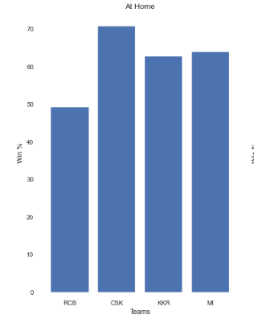
Extraneous Factors
Pressure situation
Batting
Bowling
Analysis
Does venue affect the results?
RCB win% at home is at a dismal 50%

Slide 7
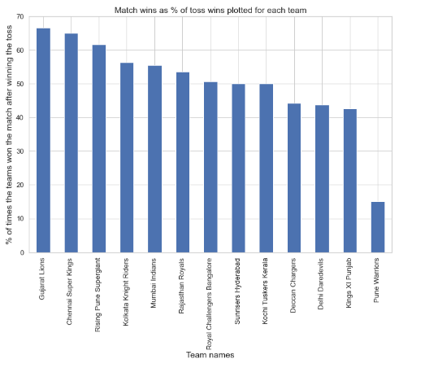
Does toss affect the results?
RCB wins only about 50% of the matches given that it won the toss

Slide 8
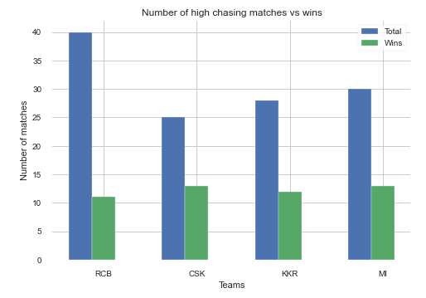
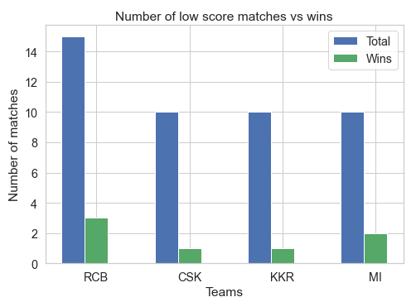
Extraneous Factors
Pressure situation
Batting
Bowling
Analysis
High Score chasing matches
Low score defending matches
Respective teams are chasing > 170 runs
Respective teams are defending < 140 runs
RCB which boasts about its strong batting line up wins only 25% of matches chasing 170+
RCB has defended low score 20% of the times which is better than other teams

Slide 9
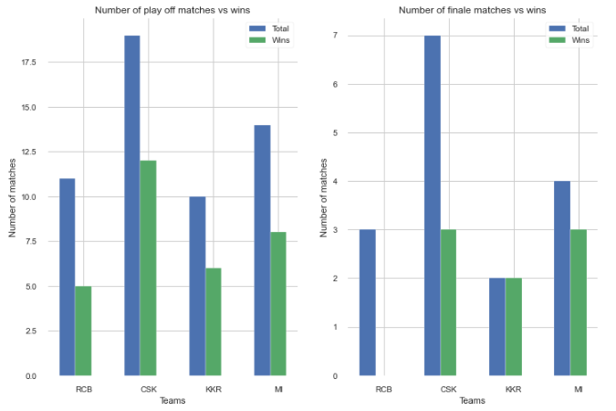
Semis / Playoffs and Finale matches
RCB has managed to win less than 50% of their matches in playoffs and have won none in finale despite reaching there thrice

Slide 10
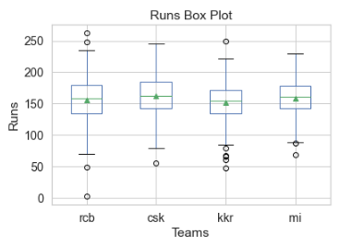
Extraneous Factors
Pressure situation
Batting
Bowling
Analysis
Scoring range for all matches
Ignoring the outliers, RCB has a higher range of scores but its quartiles and means are comparable to other teams

Slide 11
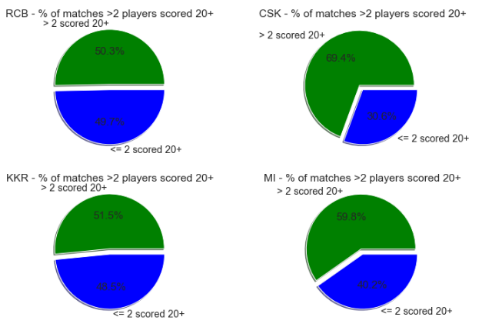
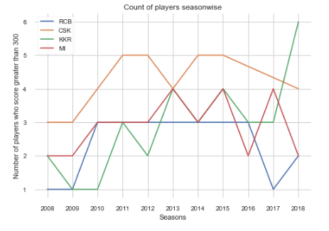
Players’ contribution
% of matches when more than 2 players scored 20+ runs
No of players who score 300+ runs in a season
Very less players are contributing to the scoreboard of RCB every match. This increases pressure on few players
Very less players are contributing to the scoreboard of RCB every season. This increases pressure on few players

Slide 12
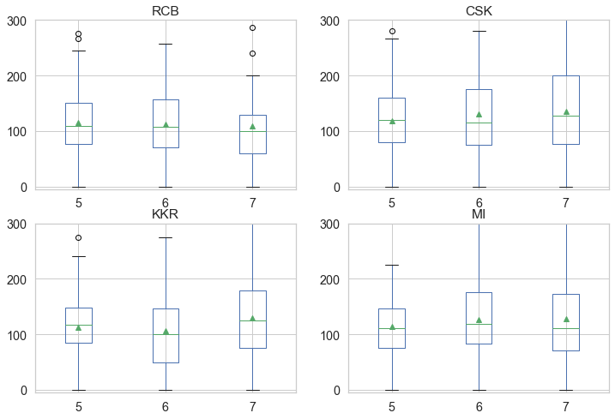
Strike rates of position 5,6 &7 for all matches
Last few overs are most important to score at high strike rates. Positions 5 & 6 have slightly lower SRs but position 7 SR is highly unacceptable.

Slide 13
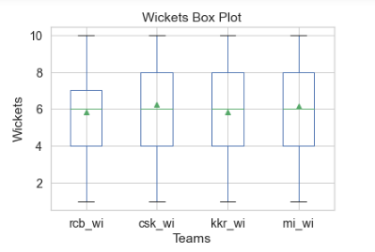
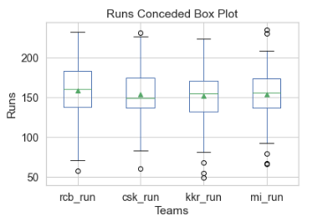
Extraneous Factors
Pressure situation
Batting
Bowling
Analysis
Wickets scalped and runs conceded range for all matches
Mean and Quartile 3 of RCB is lower for RCB i.e. they have scalped lesser wickets than any other team on an average and in Quarter 3
Mean and Quarter 2 & 3 are higher for RCB, i.e. they have conceded more runs than any other team on an average and in Quarter 3

Slide 14
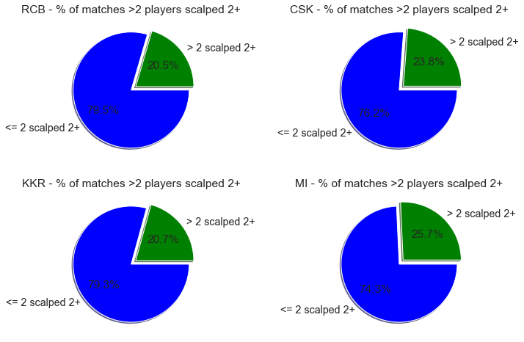
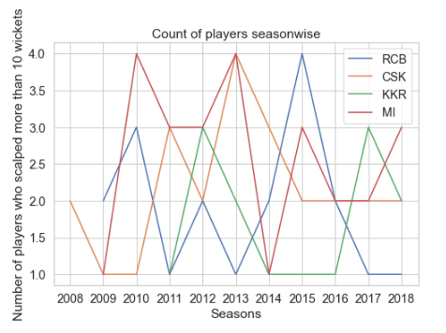
Players’ contribution
% of matches when more than 2 players scalped 2+ wickets
No of players who scalped more than 10 wickets in a season
Very less players are contributing to the wickets tally of RCB every match. This increases pressure on few bowlers
Very less players are contributing to the wickets tally of RCB every season. This increases pressure on few bowlers

Slide 15
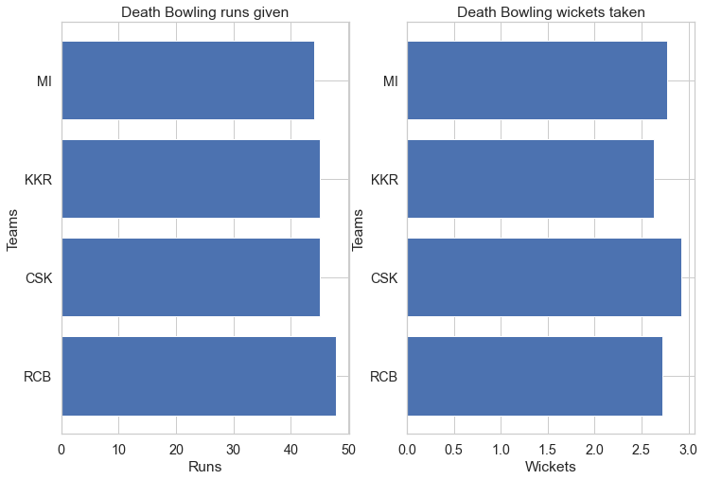
Analysis of death bowling – Runs conceded and wickets scalped
RCB’s bowling is subpar during the death overs. Wicket taking ability is also slightly lower as compared to MI and CSK even though its approx. equal to KKR

Slide 16
Actionable Insights
Extraneous Factor
Pressure situation
Batting
Bowling
Can consult experts / send vice-captain to attend the toss as toss is an important factor
Look into options such as altering the pitch, setting the boundaries according to team’s strength
Hire psychologist to train players to tackle pressure situations and keep calm
Backing, contribution of every team member and having self-confidence to face any challenges
More players need to contribute runs, improve positions 5&6 to reduce pressure on top 4 .
Necessary to find an all-rounder batsmen for position 7. He is going to make a difference in close encounters, high chases and when the top positions falls quickly
Needs to select more wicket taking bowlers. That will indirectly help in putting runs on a leash
Death bowling is an art of mixing up the balls, holding nerve and reading the batsman. Training in this area needs to be provided or experts should be selected during auction

